Slide 1
Like subscribe and share this channel
Complete course of physics
Success booster series
LINK IN DESCRIPTION DOWNLOAD NOW
ALS0 USEFUL FOR BOARD EXAMS AND NEET
Anguler momentum and its conservation
Basic part

Slide 2
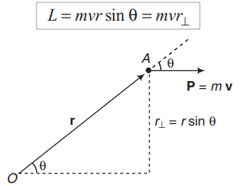

Slide 3
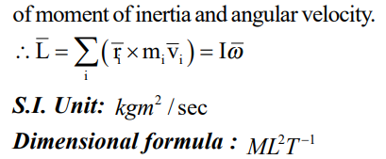

Slide 4
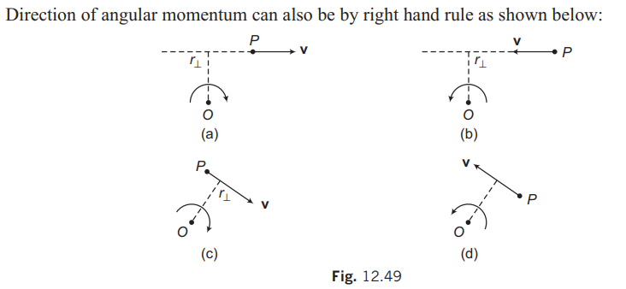

Slide 5
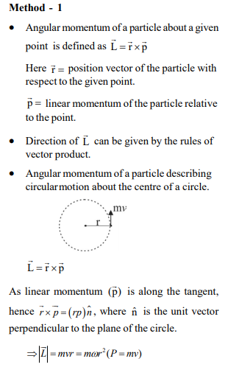

Slide 6
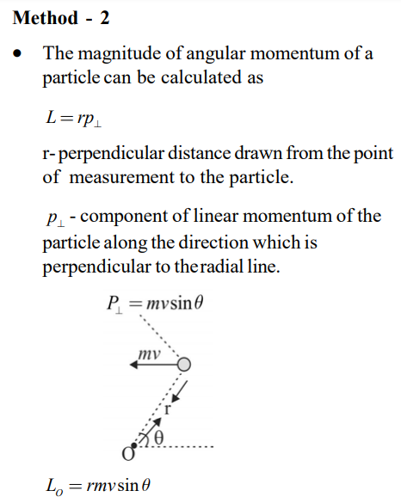

Slide 7
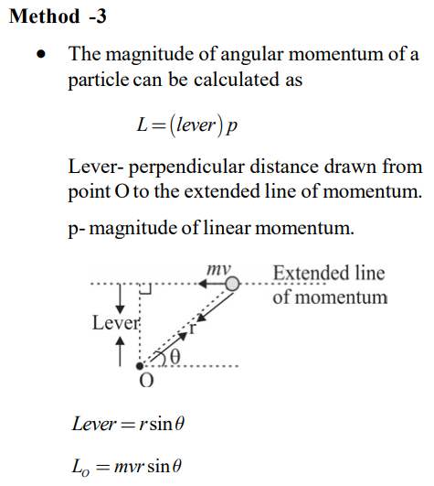

Slide 8
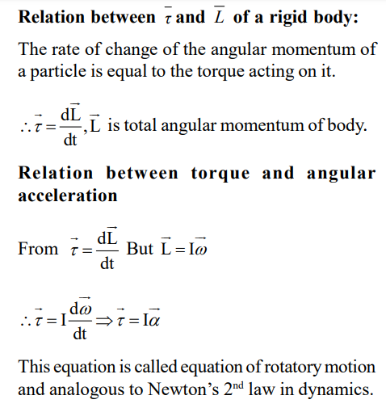

Slide 10
